Slide 1
CHAPTER 1 INTRODUCTION TO MARKETING
DEFINITION OF MARKETING
Marketing is a social and managerial process by which individuals and groups obtain what they need and want through creating and exchanging products and values with others.
-Philip Kotler
CUSTOMER ORIENTATION
The purpose of a business is to create and maintain satisfied, profitable customers. Customers
are attracted and retained when their needs are met. Many companies today have a customer focus (or market orientation). This implies that the company focuses its activities and products on consumer demands.
There are 4 basic stages for customer orientation
Develop
Development has to be done keeping customer needs into mind.
Products should be customer oriented.
The development cycle time should be minimal
Manufacture
As per the product, the manufacturing should be such that it gives the best products to the customer
Quality should not be compromised
Manufacturing cycle time should be reduced
Market
Identifying and targeting the right customer
Processing the demand as early as possible
Customization of the products for the market
Deliver
Deliver to the target customer
Reduce delivery time
Value for money products

Slide 2
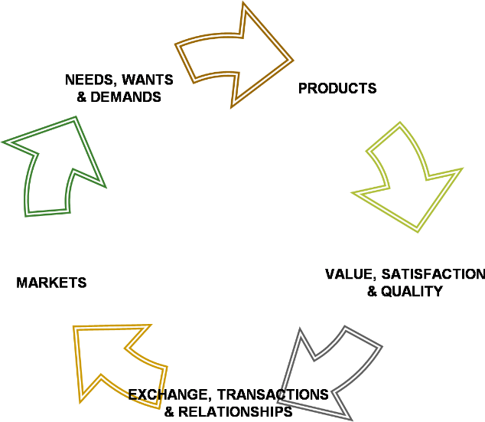
CORE CONCEPTS OF MARKETING
NEEDS
Needs are what we require to live a normal, healthy life. There are some needs that are in-built in us. These are called basic needs e.g good food to eat, we need fresh air to breathe, and clean water to drink. As we grow up, we develop a number of needs as our requirements grow with maturity. These needs are called acquired needs. E.g we need love from our family,friendship,etc
WANTS
Wants are our expression of satisfaction of needs. The situations that we encounter in our day to day lives are different. Our family background,literacy level,attitude, thinking pattern,social status,etc are different. Hence even though our needs may be the same, the way we satisfy our needs are different.
DEMAND
Demand is willingness to satisfy the need supported by the ability. The term demand signifies the ability or the willingness to buy a particular commodity at a given point of time.
PRODUCT
Product is anything that can be offered to the market for attention, acquisition, use or consumption and that which might satisfy the need or wants. Products belonging to the following categories:
Goods
Services
Events
Experiences
Persons

Slide 3
Places
Properties
Organizations
Information
Ideas
VALUE
Value to a customer refers to the difference between the benefit he derives from the product or service and the cost of acquiring the product.
Value = Benefits =
Costs
Functional Benefits+ Emotional Benefits
Monetary Costs +Time Costs+ Energy Costs+ Psychic Costs
COST
Cost refers to the combination of economic and non-economic investment the customer makes in order to acquire, consume, maintain or to disperse of the product. The following
are the various costs that that the customers have to consider before purchase.
Total cost
Monetary cost
Time cost
Energy cost
Psychic cost
Energy cost
SATISFACTION
It is the gratification or fulfillment of need, desire or appetite. It is a measure of how products and services supplied by a company meet or surpass customer expectation. It is seen as a key performance indicator within business.
EXCHANGE
It is the process of obtaining a desired product from someone by offering something in return. For exchange to exist, following conditions must be satisfied.
There are at least two parties
Each party has something that can be of value to the other party
-
TRANSACTION
It is the trade of values between two or more parties. Transaction takes place as soon as the agreement is reached. Transactions finally end up with exchange.

Slide 4
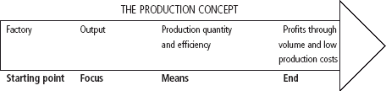
MARKET
A market is a physical place where buyers and sellers gather to buy and sell goods.
Markets are also defines as a collection of buyers and sellers who transact over a particular product or product class.eg. money markets.
PHILOSOPHIES OF MARKETING MANAGEMENT
There are five alternative concepts under which organizations conduct their marketing activities: the production, product, selling, marketing, and societal marketing concepts.
THE PRODUCTION CONCEPT
The production concept holds that customers will favor products that are available and
highly affordable and that management should therefore focus on improving production and distribution efficiency. The production concept is useful when:
Demand for a product exceeds the supply.
The product's cost is too high and improved productivity is needed to bring it down. The risk with this concept is in focusing too narrowly on company operations. Do not ignore the desires of the market.
II) THE PRODUCT CONCEPT
The product concept states that consumers will favor products that offer the most quality, performance, and features, and that the organization should therefore devote its energy to making continuous product improvements. Organizations practicing the product concept assume that a customer will buy the product of highest quality, but these organizations fail because they do not attempt to study the needs and wants of the customers.

Slide 5


III) THE SELLING CONCEPT
Many organizations follow the selling concept. The selling concept is the idea that consumers will not buy enough of the organization's products unless the organization undertakes a large- scale selling and promotion effort. This concept is typically practiced with unsought goods (those that buyers do not normally think of buying. To be successful with this concept, the organization must be good at tracking down the interested buyer. Industries that use this concept usually have overcapacity. Their aim is to sell what they make rather than make what will sell in the market. There are not only high risks with this approach but low satisfaction by customers.
THE MARKETING CONCEPT
The marketing concept puts customers twice in the entire business cycle- in the beginning as
well as at the end of the business cycle. It assumes that the business should start with the determination of consumer needs and wants and it should end with the satisfaction of those needs and wants. According to the marketing concept, any business should be organized around the marketing function and it should strive to anticipate, stimulate and meet customer’s expectations.
THE SOCIETAL MARKETING CONCEPT
Societal marketing concept holds that organization should not develop marketing strategy by
only keeping customer needs and wants in mind but also consider the well being and betterment of society. Now days this marketing concept is followed by majority of organizations including MacDonald’s, Unilever and Procter & gamble. This marketing strategy passes out positive message to the stakeholder, partners, Government, customer and public.Those organizations working on this marketing strategy communicating the message

Slide 6
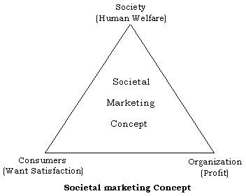
to the world those they are not only working for the profits but also for the well being of the society.
7 P’S OF MARKETING MIX

Slide 7
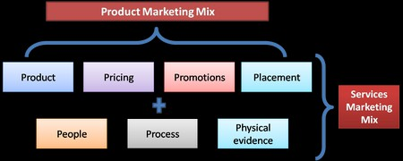
PRODUCT
The product in service marketing mix is intangible in nature. Like physical products such as a soap or a detergent, service products cannot be measured. Tourism industry or the education industry can be an excellent example. At the same time service products are heterogenous, perishable and cannot be owned. The service product thus has to be designed with care.
PLACE
Place in case of services determine where is the service product going to be located. The best
place to open up a petrol pump is on the highway or in the city. A place where there is minimum traffic is a wrong location to start a petrol pump. Similarly a software company will be better placed in a business hub with a lot of companies nearby rather than being placed in a town or rural area.
PROMOTION
Promotions have become a critical factor in the service marketing mix. Services are easy to be duplicated and hence it is generally the brand which sets a service apart from its counterpart. You will find a lot of banks and telecom companies promoting themselves rigorously. Why is that? It is because competition in this service sector is generally high and promotions is necessary to survive.
PRICING
Pricing in case of services is rather more difficult than in case of products. If you were a
restaurant owner, you can price people only for the food you are serving. But then who will pay for the nice ambience you have built up for your customers? Who will pay for the band you have for music? Thus these elements have to be taken into consideration while costing. Generally service pricing involves taking into consideration labor, material cost and overhead costs. By adding a profit mark up you get your final service pricing.

Slide 8
PEOPLE
People are one of the elements of service marketing mix. People define a service. If you have an
IT company, your software engineers define you. If you have a restaurant, your chef and service staff defines you. If you are into banking, employees in your branch and their behavior towards customers define you. In case of service marketing, people can make or break an organization.
PROCESS
Service process is the way in which a service is delivered to the end customer. Let’s take the example of two very good companies – McDonalds and FedEx. Both the companies thrive on their quick service and the reason they can do that is their confidence on their processes. On top of it, the demand of these services is such that they have to deliver optimally without a loss in quality. Thus the process of a service company in delivering its product is of utmost importance.
PHYSICAL EVIDENCE
As said before, services are intangible in nature. However, to create a better customer
experience tangible elements are also delivered with the service. Take an example of a restaurant which has only chairs and tables and good food, or a restaurant which has ambient lighting, nice music along with good seating arrangement and this also serves good food. Which one will you prefer? The one with the nice ambience. That’s physical evidence.

